Slide 1
Logan City municipal water modeling
Prepared by: Muhammad Imran
Nour Atallah
Instructor: Dr. David Rosenberg
CEE-6490 River Basin Planning
04-28-2016

Slide 2
Outline
Problem Statement
Objective
Background
Forecasting
Performance Metrics
Alternatives and Alternative Evaluation
Conclusion

Slide 3
Problem Statement
Stakeholder
City of Logan
The city of Logan is facing a increase level of population growth, which will result in failure of system to meet future demand in 2050.

Slide 4
Background
Logan is a county seat in Cache County, Utah
Water rights for municipal use in Logan are 79 cfs
Water supply capacity is 69 cfs mainly through DeWitt Springs
Logan City Public Works Department

Slide 5
Objectives
Make recommendations for structural and non-structural improvements to current water supply systems.
Examine how the proposed system will improve the current situation using WEAP.

Slide 6
Demand Calculation for Logan
Annual total demand = 12,000 ac-ft
Monthly demand in Winter season = 3.2% of total demand
384 ac-ft
Multiplied by 5 to winter demand
Monthly demand in Summer season = 12% of total demand
1,440 ac-ft
Multiplied by 7 to get summer demand

Slide 7
Performance Metrics
Reliability, Resiliency and Vulnerability (RRV)
Water supply system performance indicator
Unmet Demand (AF)
Systems inability to meet the municipal demand

Slide 8
Management Alternatives
Non - Structural Measure
Reduce the per capita water demand by 25%
Structural Measure
Build and operate the Above Cutler Reservoir

Slide 9
Scenarios for WEAP Modelling
Reference Scenario
Scenario with water conservation
Scenario with Above Cutler reservoir
Scenario with water conservation and Above Cutler reservoir

Slide 10
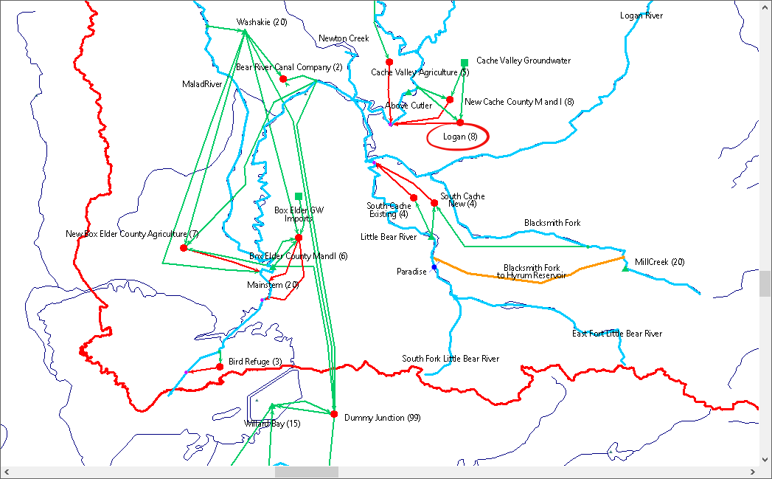
WEAP Model

Slide 11
Alternatives Evaluation (WEAP Outputs)
Scenario/Indicator | Reliability (%) | Resiliency (%) | Vulnerability (AF)
Reference | 82.72 | 22.35 | 1,393.59
Reduced Demand | 82.72 | 22.35 | 1,071.46
Above Cutler | 87.6 | 23.23 | 1,360.78
Above Cutler and Reduced Demand | 88.01 | 27.12 | 1,064.32

Slide 12
Evaluation Relative to Reference
Scenario/Indicator | Reliability (%) | Resiliency (%) | Vulnerability (%)
Reduced Demand | 00.00 | 00.00 | 23.12
Above Cutler | 5.9 | 17.34 | 2.35
Above Cutler and Reduced Demand | 6.39 | 21.32 | 23.63

Slide 13
Alternative Evaluation

Slide 14
Alternative Evaluation

Slide 15
Alternative Evaluation (Unmet Demand)
 | Oct. | Nov. | Dec. | Jan. | Feb. | Mar. | Apr. | May. | June. | Jul. | Aug. | Sep.
Reference | 451 | 0.0 | 0.0 | 0.0 | 0.0 | 0.0 | 0.0 | 35 | 315 | 578 | 724 | 786
Reduced Demand | 338 | 0.0 | 0.0 | 0.0 | 0.0 | 0.0 | 0.0 | 26 | 245 | 457 | 562 | 593
Above Cutler | 451 | 0.0 | 0.0 | 0.0 | 0.0 | 0.0 | 0.0 | 0.0 | 108 | 306 | 443 | 716
Combined | 338 | 0.0 | 0.0 | 0.0 | 0.0 | 0.0 | 0.0 | 0.0 | 87 | 233 | 334 | 539
Units in AF

Slide 16
WEAP Outputs (Bear River Canal Company)
Scenario/Indicator | Reliability (%) | Resiliency (%) | Vulnerability (AF)
Reference | 85 | 100 | 9,871
Reduced Demand | 85 | 100 | 9,959
Above Cutler | 90 | 100 | 8,351
Combined | 90 | 100 | 8,351

Slide 17
WEAP Outputs (Bear River Migratory Bird Refugee)
Scenario/Indicator | Reliability (%) | Resiliency (%) | Vulnerability (AF) | Monthly Bird Use (%)
Reference | 84 | 30 | 25,326 | 88.29
Reduced Demand | 85 | 30 | 25,359 | 88.43
Above Cutler | 89 | 35 | 23,682 | 93
Combined | 90 | 35 | 23,836 | 93

Slide 18
WEAP Outputs (Pacific Corp)
Scenario/Indicator | Annual Avg. Unmet Demand Relative to Reference (%) | Annual Avg. Power Generated Relative to Reference (MW)
Reduced Demand | -6% | 4
Above Cutler | +161.5% | 47
Combined | +170% | 48
+: Excess
- : Deficit

Slide 19
Overall Evaluation
1 : Reduced Demand Scenario
2 : Above Cutler Reservoir Scenario
3 : Combined Scenario
Stakeholder/Indicator | Reliability (%) |  |  | Resiliency (%) |  |  | Vulnerability (AF)
Scenario | 1 | 2 | 3 | 1 | 2 | 3 | 1 | 2 | 3
Logan | 87.72 | 87.6 | 88 | 22.35 | 23.23 | 27.12 | 1,071.5 | 1,360.8 | 1,064
BRCC | 85 | 90 | 90 | 100 | 100 | 100 | 9,959 | 8,351 | 8,351
BRMBR | 85 | 89 | 90 | 30 | 35 | 35 | 25,359 | 23,682 | 23,836
Avg. | 86 | 89 | 89 | 51 | 52 | 54 | 12,130 | 11,131 | 11,084

Slide 20
Conclusion and Recommendations
Reduce Demand: it was obvious that reducing the residential water use by (25%) did not make that significant improvements on the system performance metrics relative to the base case.
Above Cutler Reservoir: Building and operating the reservoir will be a very good option if considered.
Reduce Demand & Above Cutler Reservoir: Even this system improved the performance criteria, the system did not show that significant improvement comparing to Above Cutler Reservoir scenario.

Slide 21
Questions ?

Slide 22
References
J. R. Lund (2008). “Approaches to Planning Water Resources”
Logan Public Works Department (2015), “Logan Water Conservation Plan”
www.loganutah.org/document_center/.../Water%20Conservation.pdf
Utah Division of Water Rights (2016), “Public Water Supplier Information
http://www.waterrights.utah.gov/cgi-bin/wuseview.exe?Modinfo=Pwsview&SYSTEM_ID=1112
Wikipedia webpage, “Logan, Utah” - https://en.wikipedia.org/wiki/Logan,_Utah

